Slide 1
Chapter 3
Rendering Details
Resumes of the book
Computer Graphics using Java 2D and 3D
Computação Gráfica
Prof. Carlos Carreto
Engenharia Informática
Instituto Politécnico da Guarda

Slide 2
Objectives
Understand the color spaces.
Use the Color class.
Use different types of paints in drawing objects.
Apply different types of strokes.
Construct related transformations including translation, rotation, scale, shear and reflection.
Understand the difference between transforming objects and transforming visualization.
Combine basic transformations to form more complex transformations.
Identify composition rules to create transparency.
Use clipping path.
Apply fonts and font metrics.
Understand glyph, ligature and derived font.

Slide 3

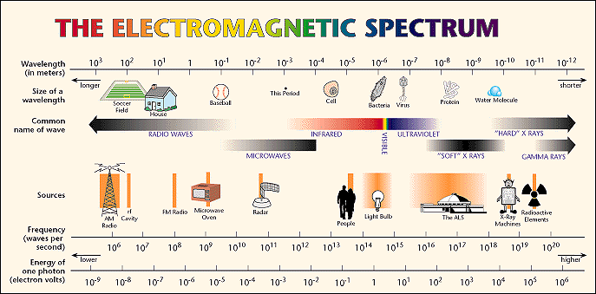
Color
Visibel Spectrum
720 nm
390 nm

Slide 4
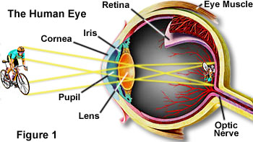
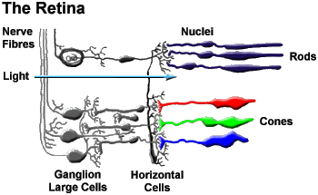
Human Eye
The cones capture the blue, red and green light rays. They are the cells of color vision and daytime vision.
The rods are panchromatic (capture all colors) and are responsible for the perception of contrasts and luminosity. They are also responsible for night vision.

Slide 5
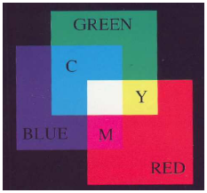
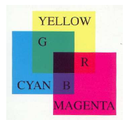
Color Formation
Additive Process: Light rays are combined to form color (this is the case for video monitors).
Subtractive Process: Color is formed using filters that eliminate certain spectral components (this is the case of slides, or printers, where pigments absorb light with certain colors and reflect the rest).
Additive Process
Subtractive Process

Slide 6
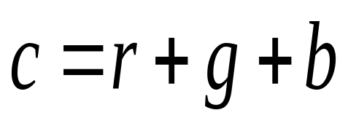
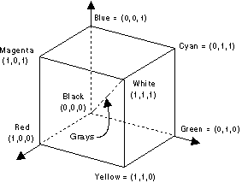
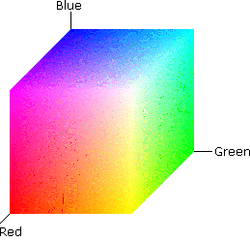
Color Spaces
A color space (color model or color system) is a specific organization of colors, that defines a way to represent a set of color wising numbers.
RGB / CYM

Slide 7
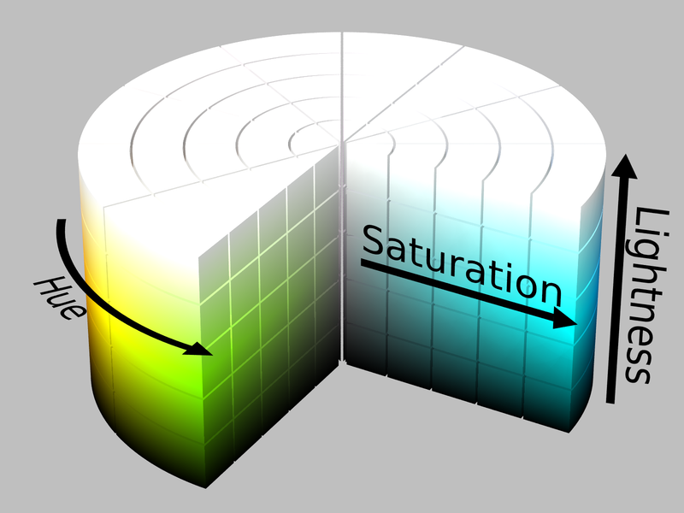
Color Spaces
HSL (Hue, Saturation, Lightness)

Slide 8
Color in Java 2D
Methods setColor(Color c)da classe Graphics
Constants Color.BLACK, Color.BLUE, Color.CYAN, …
Formation of colors:
  Color(int r, int g, int b)
  Color(int rgb)
  Color(float r, float g, float b)
  The alfa value sets the level of transparency:
  Color(int r, int g, int b, int a)
  Color(int rgba, boolean hasAlpha)
  Color(float r, float g, float b, float a)
It is also possible to define a new color space:
  Color(ColorSpace colorSpace, float[] components, float alpha)

Slide 9
Color in Java 2D
public void paintComponent(Graphics g) {
g.setColor(Color.RED);
g.draw(new Rectangle(0, 0, 100, 100)); g.setColor(new Color(0, 255, 128));
g.draw(new Rectangle(100, 0, 100, 100)); g.setColor(new Color(0.5f, 0.0f, 1.0f));
g.draw(new Rectangle(200, 0, 100, 100));
g.setColor(new Color(13321006));
g.draw(new Rectangle(250, 200, 100, 100));
}
3 bytes: 110010110100001100101110

Slide 10
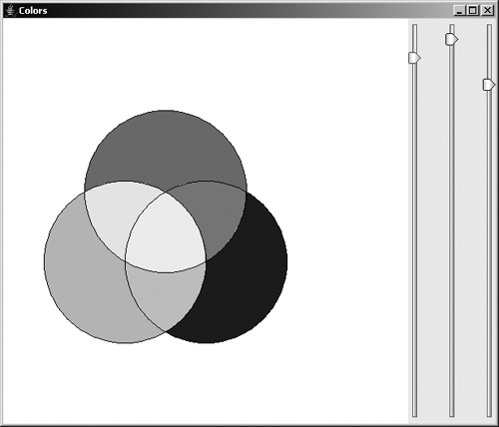
Color in Java 2D
Code
Run

Slide 11
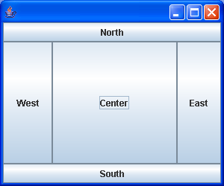
Color in Java 2D
// Detail of the use of layouts to add the JSlider
// objects to the applet.
. . .
panel = new ColorPanel();
Container cp = getContentPane();
cp.setLayout(new BorderLayout());
cp.add(panel, BorderLayout.CENTER);
JPanel p = new JPanel();
cp.add(p,BorderLayout.EAST);
p.setLayout(new GridLayout(1,3,30,10));
JSlider slider = new JSlider(JSlider.VERTICAL,0,255,100); p.add(slider);
. . .
Constructive Area Geometry is used to create seven shapes that are painted with different color combinations.
http://docs.oracle.com/javase/tutorial/uiswing/layout/visual.html

Slide 12
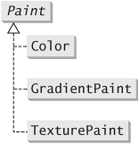
Paint
The Paint class defines how objects are painted.
The method setPaint(Paint p) of class Graphics2D allows the activation of a specific paint.
There are three implementations of the class Paint:

Slide 13
Paint
The GradientPaint class allows the objects to be painted with a color gradient than can be cyclic or acyclic (by default):
    GradientPaint(float x1, float y1, Color c1, float x2, float y2, Color c2);
    GradientPaint(Point2D p1, Color c1, Point2D p2, Color c2);
    GradientPaint(float x1, float y1, Color c1, float x2, float y2, Color c2, boolean cycl);
    GradientPaint(Point2D p1, Color c1, Point2D p2, Color c2, boolean cycl);
The TexturePaint class allows the objects to be painted with a texture:
    TexturePaint(BufferImage image, Rectangle2D anchor)

Slide 14
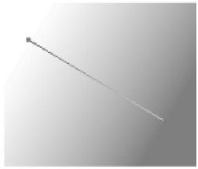
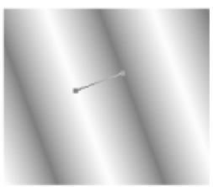
Paint
In acyclic GradientPaint the points beyond the ends of the line that defines the gradient have the same color as the endpoints of that same line.
In cyclic GradientPaint the colors continue to shift beyond the endpoints of the line, as if the line that defines the gradient is inverted and repeats forever.

Slide 15
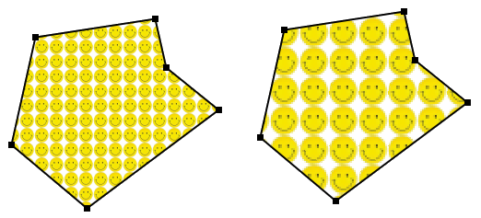
Paint
In TexturePaint the image is mapped into the rectangle which is then used as a mosaic to paint graphic objects.
TexturePaint paint = new TexturePaint( smiley, new Rectangle2D.Double( 0, 0, smiley.getWidth(), smiley.getHeight() ) );
g2.setPaint(paint);
TexturePaint paint = new TexturePaint( smiley, new Rectangle2D.Double( 0, 0, smiley.getWidth()/2, smiley.getHeight() /2) );
g2.setPaint(paint);
Smiley Image
Possible anchoring rectangles

Slide 16
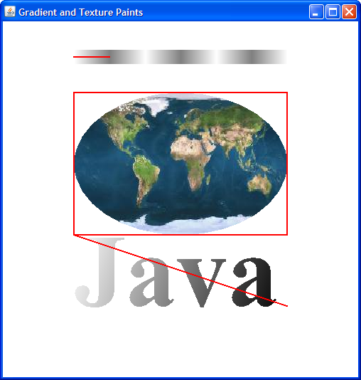
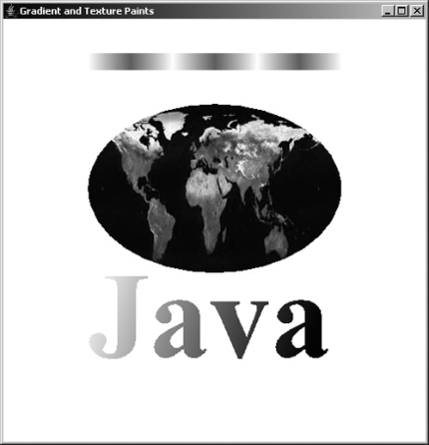
Paint
Control line
(100, 50, 150, 50)
Anchoring rectangle
(100, 100, 300, 200)
Control line
(100, 300, 400, 400)
Code
Run

Slide 17
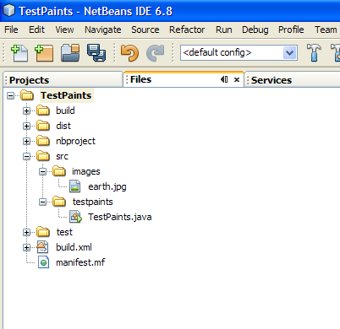
Inclusion of Resources in the Project
Image folder
private BufferedImage image;
. . .
URL url = getClass().getClassLoader().getResource("images/earth.jpg");
try {
image = ImageIO.read(url);
} catch (IOException ex) {
ex.printStackTrace();
}
. . .

Slide 18
Stroke
The Stroke interface class sets the attributes that define the details of drawing lines.
The method setStroke(Stroke s)of the class Graphics2D allows the activation of a specific stroke.
The BasicStrocke class implements the interface Stroke:
    BasicStroke()
    BasicStroke(float width)
    BasicStroke(float width, int cap, int join)
    BasicStroke(float width, int cap, int join, float miterlimit)
    BasicStroke(float width, int cap, int join, float miterlimit, float[] dash, float dashphase)

Slide 19

Stroke
End cap style
    BasicStroke(float width, int cap, int join, float miterlimit, float[] dash, float dashphase)

Slide 20

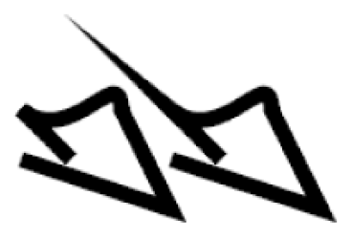
Stroke
Join style
    BasicStroke(float width, int cap, int join, float miterlimit, float[] dash, float dashphase)
Miter limit

Slide 21

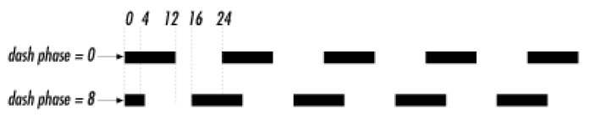
Stroke
Dash pattern
    BasicStroke(float width, int cap, int join, float miterlimit, float[] dash, float dashphase)
Of the initial 12 pixels only 4 are drawn, since dash phase is 8 (12-8 = 4)
Solid {12, 12} {4, 4, 12, 4}

Slide 22
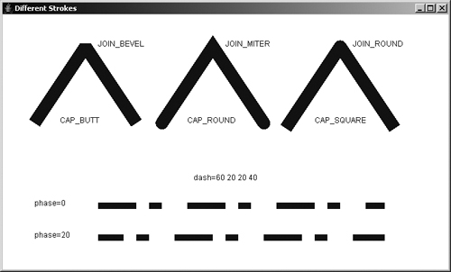
Stroke
Width
End cap style
Join style
Miter limit
Dash pattern
Code
Run

Slide 23
Affine Transformations
Affine transformations map parallel lines in parallel lines
Common affine transformations:
    Translation
    Rotation
    Scaling
    Reflection
    Shearing

Slide 24
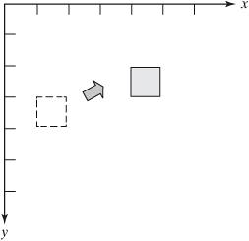
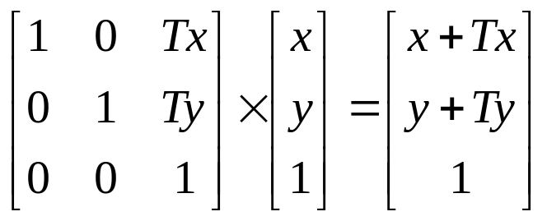
Affine Transformations
Translation
A translation moves all points of the object by a fixed amount.
It is specified by the amounts of movements in the x- and y-directions.
A translation is an isometry, since it does not change lengths and angles.
x’ = x + Tx
y’ = y + Ty
Translation represented as multiplication of matrices in homogeneous coordinates (to standardize the implementation of geometric transformations).

Slide 25
Affine Transformations
Rotation
A rotation rotates the object about a point by an angle
It is determined by the point and the angle.
A rotation is also an isometry, though it changes the orientation of the shape.
x = r . cos α
y = r . sin α
Consider r = 1 to simplify.
x’ = cos (α + θ) = cos α . cos θ – sin α . sin θ
y’ = sin (α + θ) = sin α . cos θ + cos α . sin θ
x’ = x . cos θ – y . sin θ
y’ = y . cos θ + x . sin θ
P’(x’, y’)
r
P(x, y)
r
θ
α

Slide 26
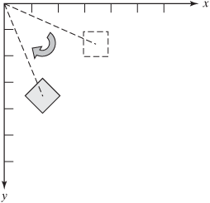
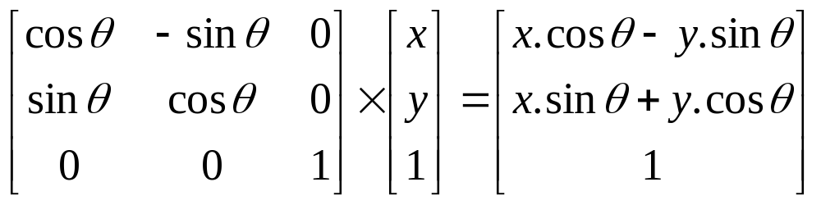
Affine Transformations
Rotation

Slide 27
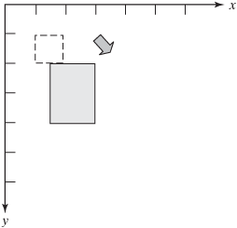
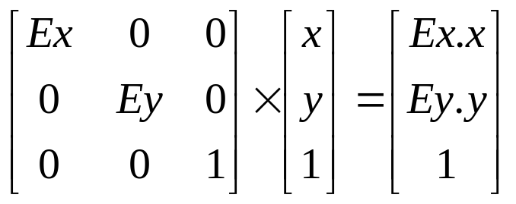
Affine Transformations
Scaling
A scaling resizes the object by certain fixed factors in the x- and y-directions.
A scaling is not an isometry, because it will change distances and angles. However, it preserves parallelism.
x’ = Ex . x
y’ = Ey . y
Note that the scale causes a translation.

Slide 28
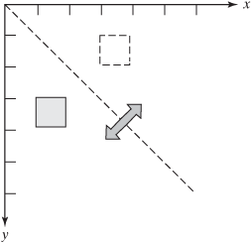
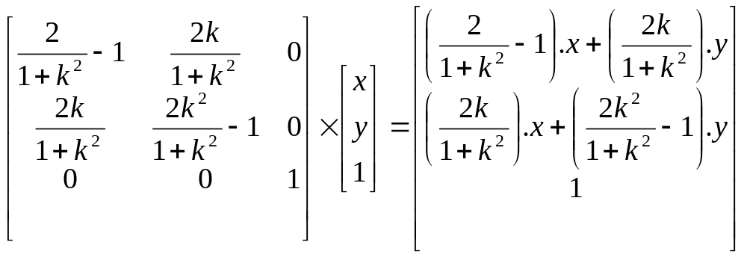
Affine Transformations
Reflection
A reflection maps the object to its mirror image about a line.
It is determined by the line.
A reflection is an isometry, though it changes the orientation of an angle.

Slide 29
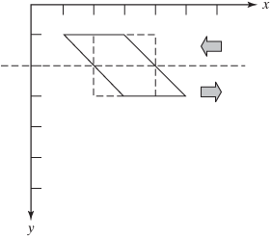
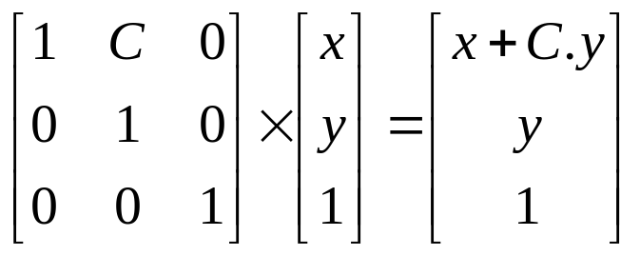
Affine Transformations
Shearing
A shearing about a line shifts a point by an amount proportional to the signed distance to the line.
The movements of the points are parallel to the line. Points on the line are not moved. Points on the opposite sides of the line are moved in the opposite directions.
A shearing is not an isometry, but it still preserves parallelism.

Slide 30
Transformations in Java 2D
Geometric Transformations
Applied to Graphic Objects
Applied to the Coordinate System
Class
AffineTransform
Class
AffineTransform
Class
Graphics2D

Slide 31
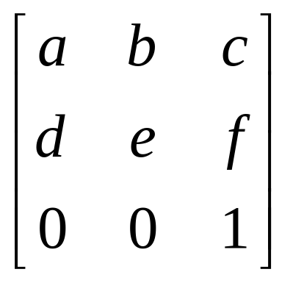
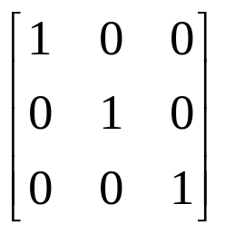
Transformations in Java 2D
  When we set up a geometric transformation with the AffineTransform class, or with the Graphics2D class, what we are doing is configuring the correspondent internal matrices that mathematically represent the transformations.
Identity Matrix (default matrix)

Slide 32
Transformations in Java 2D
  The affine transformations can be set up with the class AffineTransform.
The setTo * methods set the transform to override the one that is currently set:
    setToIdentity()
    setToRotation(double theta)
    setToRotation(double theta, double x, double y)
    setToScale(double sx, double sy)
    setToShear(double shx, double shy)
    setToTranslation(double tx, double ty)

Slide 33
Transformations in Java 2D
  Methods for configuring the transformation matrix (only the first two rows because the third is always [0 0 1]):
    AffineTransform(double m00, double m10, double m01, double m11, double m02, double m12)
    AffineTransform(float m00, float m10, float m01, float m11, float m02, float m12)
    AffineTransform(double[] flatmatrix)
    AffineTransform(float[] flatmatrix)
    void setTransform(double m00, double m10, double m01, double m11, double m02, double m12)

Slide 34

Transformations in Java 2D
  Example:
  What is the transformation defined by the following matrix?
  transform.setTransform(-1, 0, 0, 0, 1, 0);
  or
  transform.setToScale(-1, 1);

Slide 35
Transformations in Java 2D
  Objects in the AffineTransform class can be used for both object/point transformation and visualization transformation (transformation of the coordinate system).
  Methods to transform objects and set of points:
    Shape createTransformedShape(Shape shape)
    transform(double[] src, int srcOff, double[] dst, int dstOff, int numPts)
    transform(double[] src, int srcOff, float[] dst, int dstOff, int numPts)
    transform(float[] src, int srcOff, double[] dst, int dstOff, int numPts)
    transform(float[] src, int srcOff, float[] dst, int dstOff, int numPts)
    Point2D transform(Point2D src, Point2D dst)
    Point2D transform(Point2D[] src, int srcOff, Point2D[] dst, int dstOff, int numPts)
    deltaTransform(double[] src, int srcOff, double[] dst, int dstOff, int numPts)
    Point2D deltaTransform(Point2D src, Point2D dst)

Slide 36
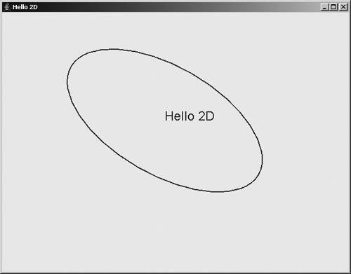
Transformations in Java 2D
public void paintComponent(Graphics g) {
super.paintComponent(g);
Graphics2D g2 = (Graphics2D)g;
g2.setColor(Color.blue);
Ellipse2D e = new Ellipse2D.Double(-100, -50, 200, 100);
AffineTransform tr = new AffineTransform();
tr.rotate(Math.PI / 6.0);
Shape shape = tr.createTransformedShape(e);
g2.translate(300,200);
g2.scale(2,2);
g2.draw(shape);
g2.drawString("Hello 2D", 0, 0);
}

Slide 37
Transformations in Java 2D
  Visualization transformation is performed with the Graphics2D object:
  The setTransform(AffineTransform tx) method, of the Graphics2D class, replaces the current transform with the passed transform as a parameter.
  The transform(AffineTransform tx) method, of the Graphics2D class, concatenates (combines) the current transform with the transform passed as parameter.

Slide 38
Transformations in Java 2D
  The Graphics2D class has its own methods that concatenate its transformations to the current visualization transformation:
    public abstract void translate(double tx, double ty)
    public abstract void rotate(double theta)
    public abstract void rotate(double theta, double x, double y)
    public abstract void scale(double sx, double sy)
    public abstract void shear(double shx, double shy)

Slide 39
Transformations in Java 2D
public void paintComponent(Graphics g) {
super.paintComponent(g);
Graphics2D g2 = (Graphics2D)g;
g2.setColor(Color.blue);
Ellipse2D e = new Ellipse2D.Double(-100, -50, 200, 100);
AffineTransform tr = new AffineTransform();
tr.rotate(Math.PI / 6.0);
Shape shape = tr.createTransformedShape(e);
g2.translate(300,200);
g2.scale(2,2);
g2.draw(shape);
g2.drawString("Hello 2D", 0, 0);
}

Slide 40
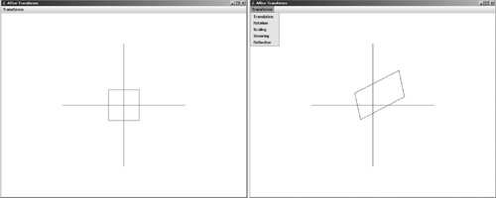
Transformations in Java 2D
Code
Run

Slide 41
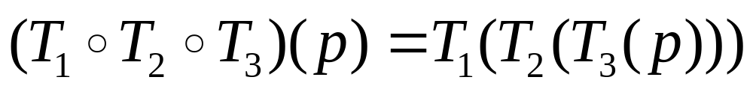
Composition of Transformations
Complex transformations can be created from the composition (combination) of simpler transformations
T₁ º T₂ º T₃
The composition of transformations corresponds to the multiplication of the respective transformation matrices
M₁M₂M₃
The composition of transformations is non-commutative (order is important)
By convention, the transformations are applied from right to left

Slide 42
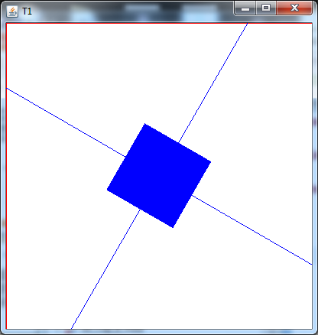
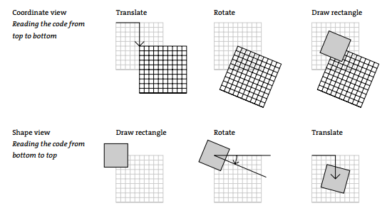
Composition of Transformations
public void paintComponent(Graphics g) {
super.paintComponent(g);
Graphics2D g2 = (Graphics2D) g;
w = getWidth();
h = getHeight();
drawAxis(g2, Color.RED);
g2.translate(w/2, h/2);
g2.rotate(Math.toRadians(30));
drawAxis(g2, Color.BLUE);
Shape r = new Rectangle2D.Double(-50, -50, 100, 100);
g2.fill(r);
//The composition of transformations is not commutative
//g2.rotate(Math.toRadians(30));
//g2.translate(w/2, h/2);
//drawAxis(g2, Color.BLUE);
//Shape r = new Rectangle2D.Double(-50, -50, 100, 100);
//g2.fill(r);
}
void drawAxis(Graphics2D g2, Color c) {
g2.setColor(c);
g2.drawLine(-400, 0, 400, 0);
g2.drawLine(0, -400, 0, 400);
}
Two ways of interpreting composite transformation: from the point of view of the coordinate system and the point of view of the object.

Slide 43
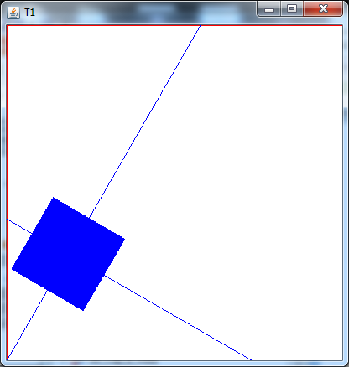
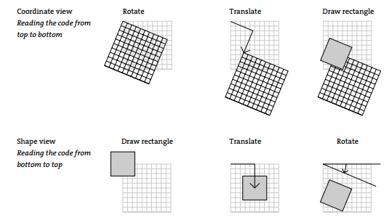
Composition of Transformations
public void paintComponent(Graphics g) {
super.paintComponent(g);
Graphics2D g2 = (Graphics2D) g;
w = getWidth();
h = getHeight();
drawAxis(g2, Color.RED);
//g2.translate(w/2, h/2);
//g2.rotate(Math.toRadians(30));
//drawAxis(g2, Color.BLUE);
//Shape r = new Rectangle2D.Double(-50, -50, 100, 100);
//g2.fill(r);
// The composition of transformations is not commutative
g2.rotate(Math.toRadians(30));
g2.translate(w/2, h/2);
drawAxis(g2, Color.BLUE);
Shape r = new Rectangle2D.Double(-50, -50, 100, 100);
g2.fill(r);
}
void drawAxis(Graphics2D g2, Color c) {
g2.setColor(c);
g2.drawLine(-400, 0, 400, 0);
g2.drawLine(0, -400, 0, 400);
}

Slide 44
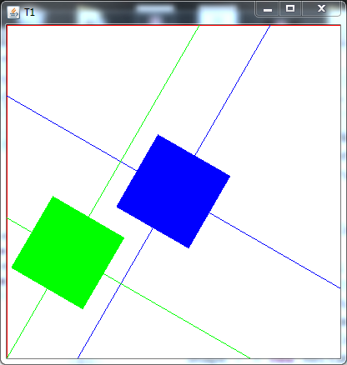
Composition of Transformations
  Restore the previous graphical context
    Storing and activating previous contexts
    Managing a stack of contexts
It is sometimes necessary to apply geometric transformations one after another, but in such a way that the previous transformations do not affect subsequent transformations. That is, it is necessary to restore previous graphical contexts

Slide 45
Composition of Transformations
public void paintComponent(Graphics g) {
super.paintComponent(g);
Graphics2D g2 = (Graphics2D) g;
w = getWidth();
h = getHeight();
drawAxis(g2, Color.RED);
AffineTransform oldTransform=g2.getTransform();
// The composition of transformations is not commutative
g2.translate(w/2, h/2);
g2.rotate(Math.toRadians(30));
drawAxis(g2, Color.BLUE);
Shape r = new Rectangle2D.Double(-50, -50, 100, 100);
g2.fill(r);
g2.setTransform(oldTransform);
g2.rotate(Math.toRadians(30));
g2.translate(w/2, h/2);
drawAxis(g2, Color.GREEN);
r = new Rectangle2D.Double(-50, -50, 100, 100);
g2.fill(r);
}
    Technique to restore the previous transformation context, just by storing and activating previous contexts

Slide 46
Composition of Transformations
public void paintComponent(Graphics g) {
super.paintComponent(g);
Graphics2D g2 = (Graphics2D) g;
w = getWidth();
h = getHeight();
drawAxis(g2, Color.RED);
g2 = this.push(g2);
// The composition of transformations is not commutative
g2.translate(w/2, h/2);
g2.rotate(Math.toRadians(30));
drawAxis(g2, Color.BLUE);
Shape r = new Rectangle2D.Double(-50, -50, 100, 100);
g2.fill(r);
g2 = this.pop();
g2.rotate(Math.toRadians(30));
g2.translate(w/2, h/2);
drawAxis(g2, Color.GREEN);
r = new Rectangle2D.Double(-50, -50, 100, 100);
g2.fill(r);
}
private LinkedList<Graphics2D> stack = new LinkedList<Graphics2D>();
public Graphics2D push(Graphics2D g2) {
this.stack.addFirst(g2); // Save for future use
return (Graphics2D) g2.create(); // Copy the object
}
public Graphics2D pop() {
return this.stack.removeFirst(); // Restores the saved object
}
Technique to restore the previous graphical context, based on a stack of contexts.

Slide 47




Composition of Transformations
Exemple:
Rotate an object 30 degrees around the point (3, 4)
  1º Translation to make the center of rotation match the origin (T1);
  2º Rotation of 30 degrees (T2);
  3º Translation to move the center of rotation to the desired point. (T3).
Notice the order. From right to left.

Slide 48
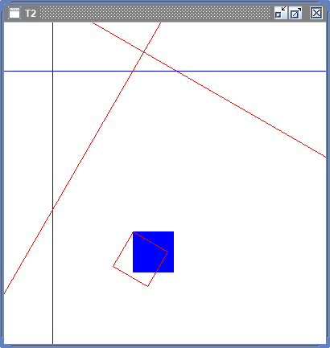
Composition of Transformations
public void paintComponent(Graphics g) {
super.paintComponent(g);
Graphics2D g2 = (Graphics2D) g;
w = getWidth();
h = getHeight();
g2.translate(60, 60);
drawAxis(g2, Color.BLUE);
// Draw of a square
Shape shape1 = new Rectangle2D.Double(100, 200, 50, 50);
g2.setColor(Color.BLUE);
g2.fill(shape1);
g2.draw(shape1);
// Composite transformation to rotate the square
// around point (100, 200)
g2.translate(100, 200);
g2.rotate(Math.PI / 6);
g2.translate(-100, -200);
drawAxis(g2, Color.RED);
g2.setColor(Color.RED);
g2.draw(shape1);
}
void drawAxis(Graphics2D g2, Color c) {
g2.setColor(c);
g2.drawLine(-w / 4, 0, w, 0);
g2.drawLine(0, -h / 4, 0, h);
}
Notice the order. From right to left.

Slide 49
Composition of Transformations
AffineTransform class methods for composing transformations (combine the current transformation with the transformation they specify):
  rotate(double theta)
  rotate(double theta, double x, double y)
  scale(double sx, double sy)
  shear(double shx, double shy)
  translate(double tx, double ty)
Methods that combine the current transformation with another transformation of the AffineTransform type:
  concatenate(AffineTransform tx) (right concatenation)
  preConcatenate(AffineTransform tx) (left concatenation)
Concatenate the new transformation to the right of those that already exist.

Slide 50
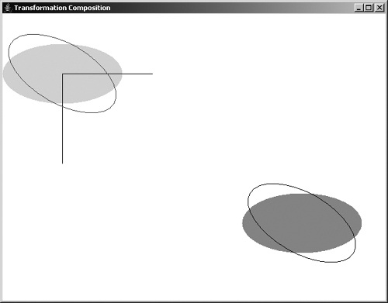
Composition of Transformations
public void paintComponent(Graphics g) {
super.paintComponent(g);
Graphics2D g2 = (Graphics2D)g;
g2.translate(100,100);
Shape e = new Ellipse2D.Double(300, 200, 200, 100);
g2.setColor(new Color(160,160,160));
g2.fill(e);
AffineTransform transform = new AffineTransform();
transform.translate(-400,-250);
e = transform.createTransformedShape(e);
g2.setColor(new Color(220,220,220));
g2.fill(e);
g2.setColor(Color.black);
g2.drawLine(0, 0, 150, 0);
g2.drawLine(0, 0, 0, 150);
transform.setToRotation(Math.PI / 6.0);
e = transform.createTransformedShape(e);
g2.setColor(new Color(100,100,100));
g2.draw(e);
transform.setToTranslation(400, 250);
e = transform.createTransformedShape(e);
g2.setColor(new Color(0,0,0));
g2.draw(e);
}
Code
Run

Slide 51
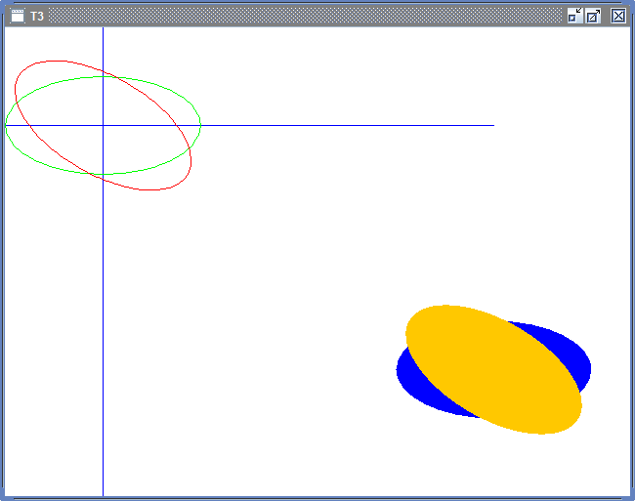
Composition of Transformations
public void paintComponent(Graphics g) {
super.paintComponent(g);
Graphics2D g2 = (Graphics2D)g;
g2.translate(100,100);
drawAxis(g2, Color.BLUE);
// Original position
Shape e = new Ellipse2D.Double(300, 200, 200, 100);
g2.setColor(Color.BLUE);
g2.fill(e);
// Translating the ellipse so that it is centered at the origin.
AffineTransform transform = new AffineTransform();
transform.translate(-400,-250);
e = transform.createTransformedShape(e);
g2.setColor(Color.GREEN);
g2.draw(e);
// Rotating the ellipse around the origin.
transform.setToRotation(Math.PI / 6.0);
e = transform.createTransformedShape(e);
g2.setColor(Color.RED);
g2.draw(e);
// Reverse translation of the first to return to the original position.
transform.setToTranslation(400, 250);
e = transform.createTransformedShape(e);
g2.setColor(Color.YELLOW);
g2.fill(e);
}
Code
Run

Slide 52
Composition of Transformations
public void paintComponent(Graphics g) {
super.paintComponent(g);
Graphics2D g2 = (Graphics2D)g;
g2.translate(100,100);
Shape e = new Ellipse2D.Double(300, 200, 200, 100);
g2.setColor(new Color(160,160,160));
g2.fill(e);
AffineTransform transform = new AffineTransform();
transform.translate(400,250);
transform.rotate(Math.PI / 6.0);
transform.translate(-400,-250);
e = transform.createTransformedShape(e);
g2.setColor(new Color(100,100,100));
g2.draw(e);
}

Slide 53
Transparency and Compositing Rules
This rules determine the result in rendering overlapping objects.
Can create various visual effects and different degrees of transparency.
Java 2D implements the Porter-Duff rules.

Slide 54
Porter-Duff Rules
Clear
SrcOver
SrcIn
SrcOut
Src
SrcAtop
Xor
DstOver
DstIn
DstOut
Dst
DstAtop

Slide 55
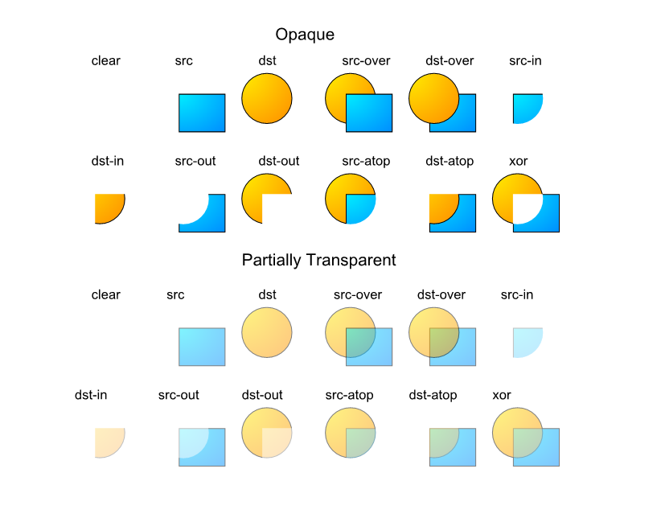
Porter-Duff Rules

Slide 56



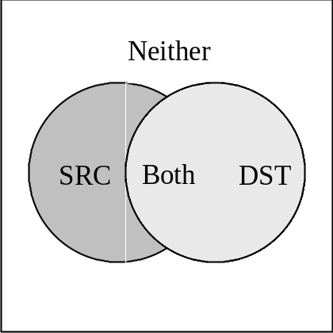

Probabilistic Model
The value of α represents the probability of the color being displayed.
Four different events:
  only source color occurs
  only the target color occurs
  both colors occur
  no color occurs.
Code
Run

Slide 57
Compositing Rules in Java 2D
The AlphaComposite class supports the 12 Porter-Duff compositing rules.
An AlphaComposite object can also have an alpha value that specifies the degree of transparency (alpha = 1.0 is completely opaque, alpha = 0.0 is fully transparent).
The setComposite() method of the Graphics2D class applies the rule.
Example (with transparency):
AlphaComposite ac = AlphaComposite.getInstance(AlphaComposite.SRC_OVER, 0.4f);
g2.setComposite(ac);

Slide 58
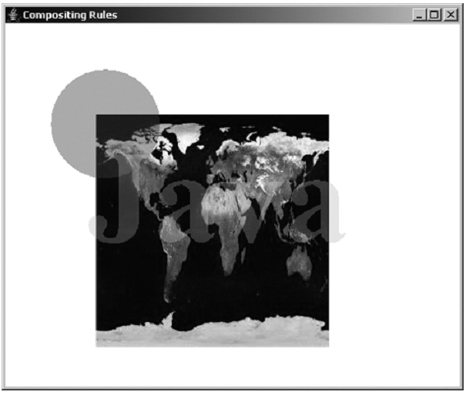
Compositing Rules in Java 2D
Code
Run

Slide 59
Clipping Path
Defines the region in which objects will be visible.
Any Shape object can be used as a clipping path.
A clipping path is defined using the setClip() method or the clip() method of the Graphics2D class.
Example:
Graphics2D g2 = (Graphics2D)g;
Shape ellipse = new Ellipse2D.Double(0, 0, 300,200);
g2.setClip(ellipse);
// everything that is drawn next will only be visible
// in the area defined by the shape ellipse

Slide 60
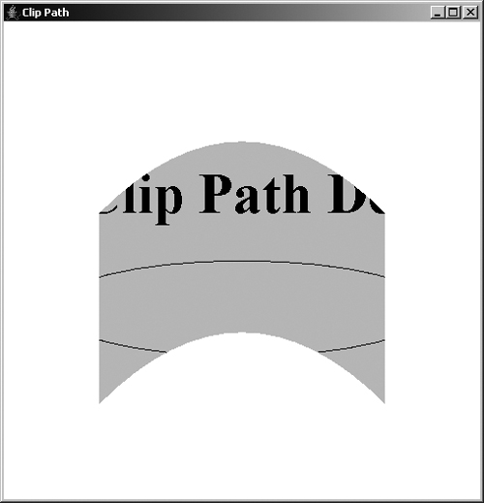
Clipping Path
Code
Run

Slide 61
Fonts
In computer graphics, text is a special kind of graphic object.
A string represents a sequence of characters using some sort of standard encoding (ASCII, Unicode, etc.).
The way string characters are drawn is determined by predefined fonts.
The geometry that describes the shape of a character is known as glyph.
A font is a collection of glyphs for all alphabet characters.

Slide 62

Ligature
Glyphs may contain more than one character.
In some fonts a two-character sequence is drawn in a combined fashion giving rise to a ligature.

Slide 63
Fonts in Java 2D
The Font class allows the creation of a font object:
  Font(String name, int style, int size)
A Font object can be selected by a Graphics2D object using the method:
  setFont(Font font)
The selected font object will define the shape of the characters drawn by the methods:
  drawString(String s, int x, int y)
  drawString(String s, float x, float y)

Slide 64
Fonts in Java 2D
It is also possible to derive fonts from other fonts by changing some attributes:
  Font deriveFont(int style)
  Font deriveFont(float size)
  Font deriveFont(int style, float size)
  Font deriveFont(AffineTransform tx)
  Font deriveFont(int style, AffineTransform tx)
  Font deriveFont(Map attributes)

Slide 65
Fonts in Java 2D
To get the measurements of the text drawn with a given font, we can use the methods of the Font class:
  Rectangle2D getStringBounds(String str, FontRenderContext frc)
  LineMetrics getLineMetrics(String str, FontRenderContext frc)
The FontRenderContext object can be obtained through the Graphics2D method:
  FontRenderContext getFontRenderContext()

Slide 66
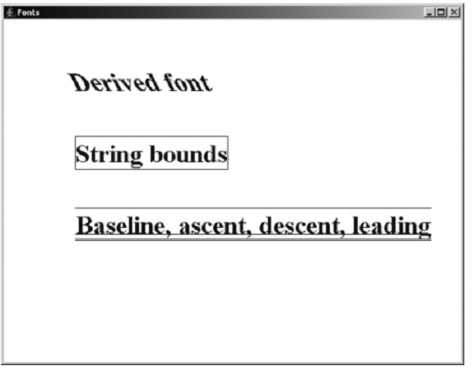
Fonts in Java 2D
Baseline is the reference line of a font. Ascent is the distance at which the font extends above the Baseline. Descent is the distance that the font extends down the baseline. Leading is the extra distance between the two lines.
Font font = new Font("Serif", Font.BOLD, 36);
AffineTransform tx = new AffineTransform();
tx.shear(0.5, 0);
g2.setFont(font.deriveFont(tx));
g2.drawString("Derived font", 100, 100);
LineMetrics lm = font.getLineMetrics(str, frc);
int y = -(int)lm.getAscent();
g2.drawLine(0, y, w, y);
g2.setFont(font);
FontRenderContext frc = g2.getFontRenderContext();
String str = "String bounds";
Rectangle2D bounds = font.getStringBounds(str, frc);
g2.translate(100, 200);
g2.draw(bounds);
g2.drawString(str, 0, 0);
str = "Baseline, ascent, descent, leading";
g2.translate(0,100);
int w = (int)font.getStringBounds(str, frc).getWidth();
g2.drawLine(0, 0, w, 0);
y = (int)lm.getDescent();
g2.drawLine(0, y, w, y);
y = (int)(lm.getDescent()+lm.getLeading());
g2.drawLine(0, y, w, y);
g2.drawString(str,0,0);
Code
Run

Slide 67
Glyph
The character glyphs of a given font can be transformed into a Shape type object. This allows the application of glyphs in the creation of varied and sophisticated visual effects.
Example:
Font font = new Font("Serif", Font.BOLD, 144);
FontRenderContext frc = g2.getFontRenderContext();
GlyphVector gv = font.createGlyphVector(frc, "Java");
Shape glyph = gv.getOutline(100,200);

Slide 68
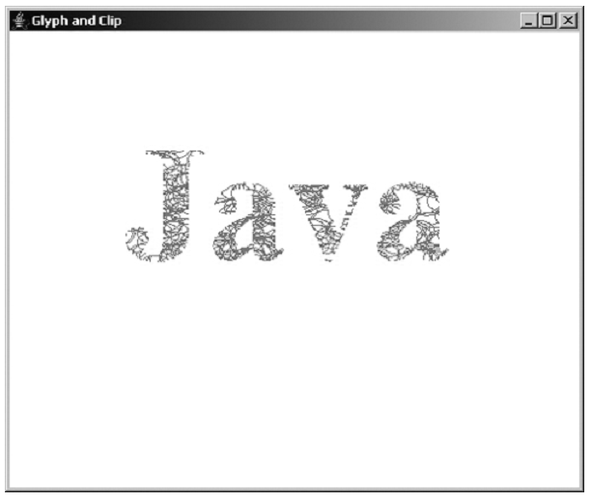
Glyph
Font font = new Font("Serif", Font.BOLD, 144); FontRenderContext frc = g2.getFontRenderContext(); GlyphVector gv = font.createGlyphVector(frc, "Java"); Shape glyph = gv.getOutline(100,200); g2.setClip(glyph); g2.setColor(Color.red); for (int i = 0; i < 2000; i++) { Shape shape = new Ellipse2D.Double(Math.random()*500, Math.random()*400, 30, 20); g2.draw(shape); }
Code
Run

Slide 69
End of Chapter 3

